Slide 1
Artificial Intelligence Model Boosting w/out Code
Self-Service AI & Deep Learning

Slide 2
Customer Problems
GOTs solution w/no more support (company dissolved)
Boost accuracy, avoid re-certification
Improve performance (GPU optimize on OpenCV)

Slide 3
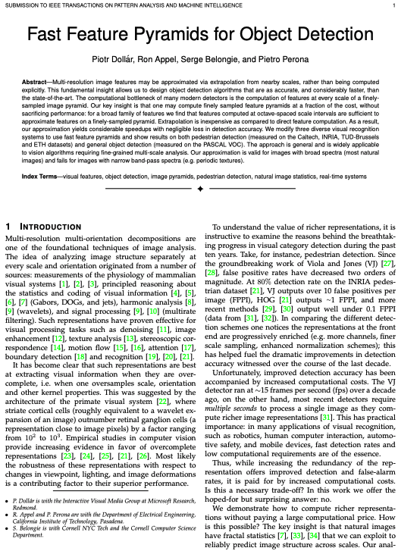
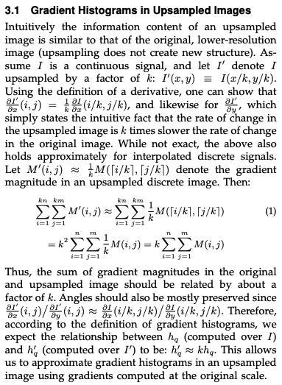
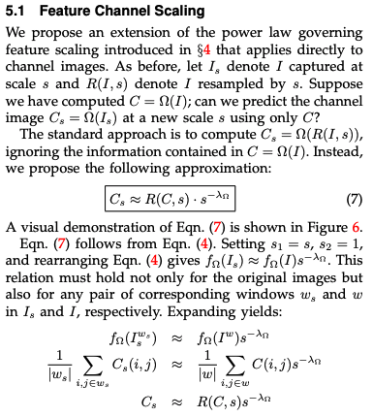
Object Detection w/ Fast Feature Pyramids

Slide 4

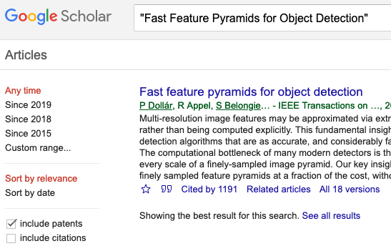
14 dense pages https://eeexplore.ieee.org/xpl
Cited 1191 times!!!

Slide 5
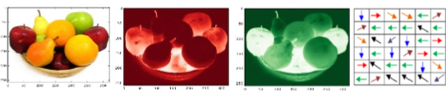
Pictographically Explained
image pyramids
aggregate feature channels (afc)
train adaboost tree ensemble
non-maximal suppression (nms)

Slide 6
What is a digital image?

Slide 7


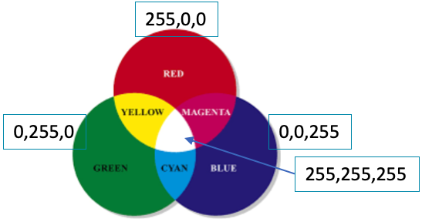

Matrix of Pixels
R:112
G:26
B:20
R:109
G:49
B:39
R:188
G:56
B:49
R:95
G:45
B:27
Matrix of pixels
Each pixel is typically 3 integers
Intensities of red, green, blue (rgb)

Slide 8
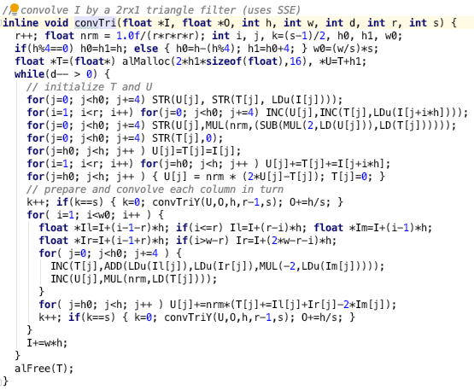
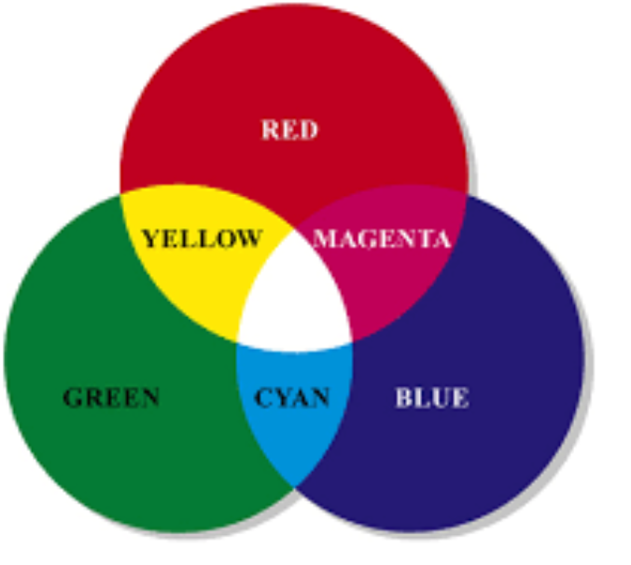
Channels Colors
So many for loops…
ripe for GPU optimization
red
green
blue
255,0,0
0,255,0
0,0,255
255,255,255

Slide 9
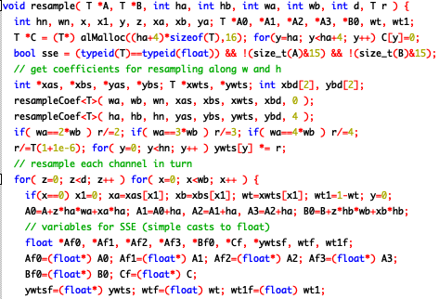
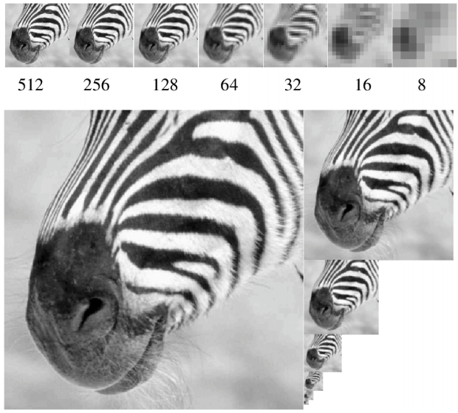
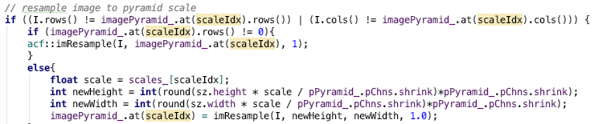
Image Pyramids
looped computations; embarrassingly parallel
order of magnitudes faster with GPU

Slide 10
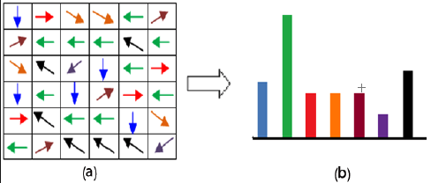
Channels Gradients
12 | 34 | 143 | 201 | 255
12 | 34 | 143 | 201 | 255
12 | 34 | 143 | 201 | 255
12 | 34 | 143 | 201 | 255
12 | 34 | 143 | 201 | 255
Gradient Direction/Orientation
As Histogram
Gradient Magnitude

Slide 11
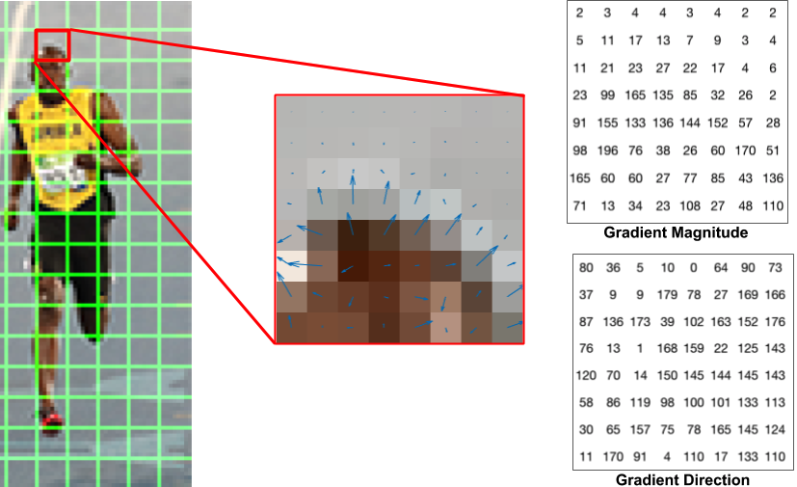
Another Gradient Explanation

Slide 12
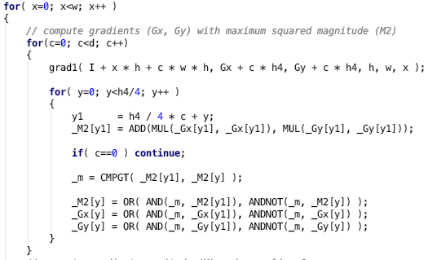
Gradient Calculations
nested for loops;
perfect for GPUs

Slide 13
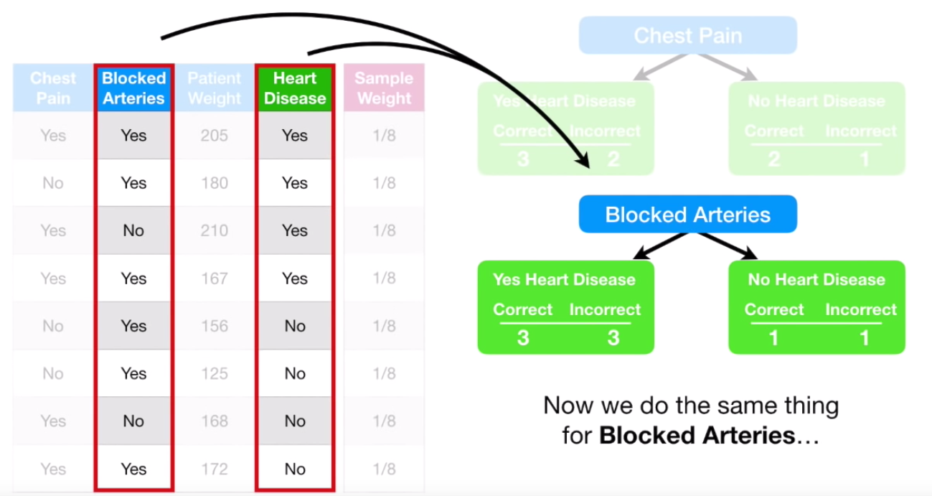
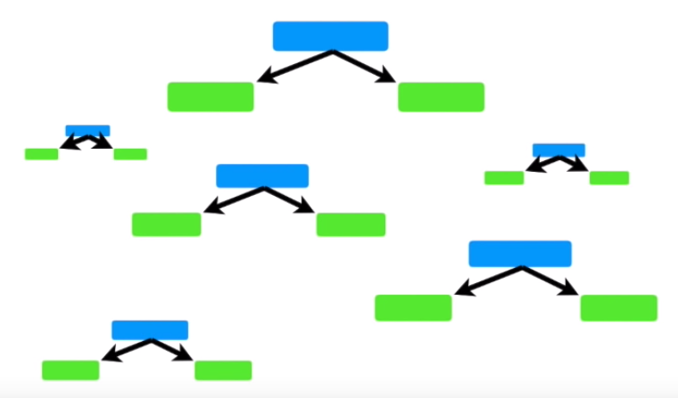
AdaBoost Ensemble Weighted Decision Trees
AdaBoost
Gradient Boosting
XGBoost
Notes:
https://www.youtube.com/watch?v=LsK-xG1cLYA

Slide 14
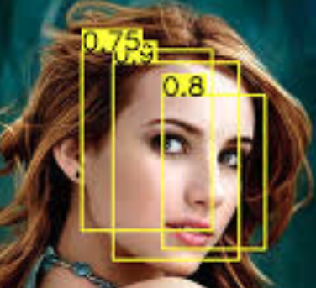
AdaBoost Ensemble Weighted Decision Trees
bounding boxes with probability

Slide 15
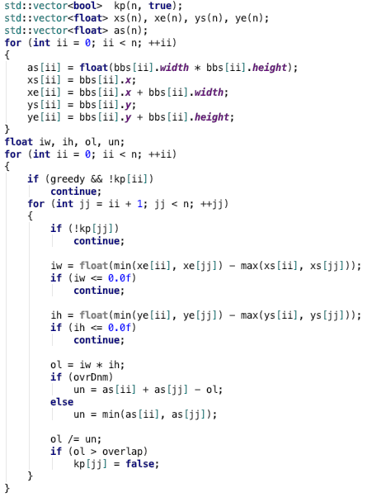
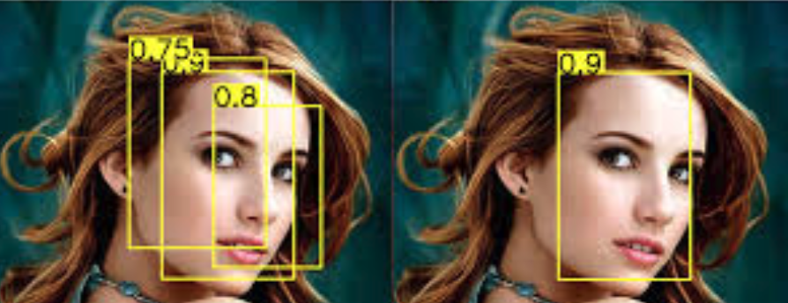
Non-Maximal Suppression
1. overlap?
intersect area / union area > 0.5 ?
2. if overlap, choose best score
nested for loop computations;
begging for GPU

Slide 16
Give me an ‘easy button’
Self-Service AI & Deep Learning

Slide 17
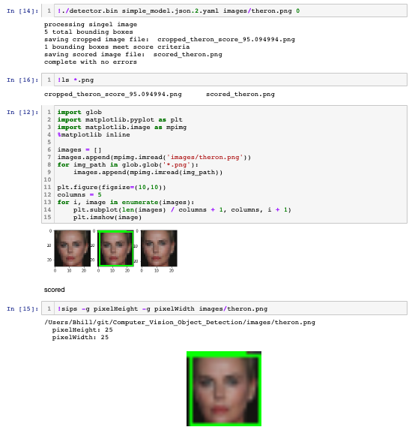
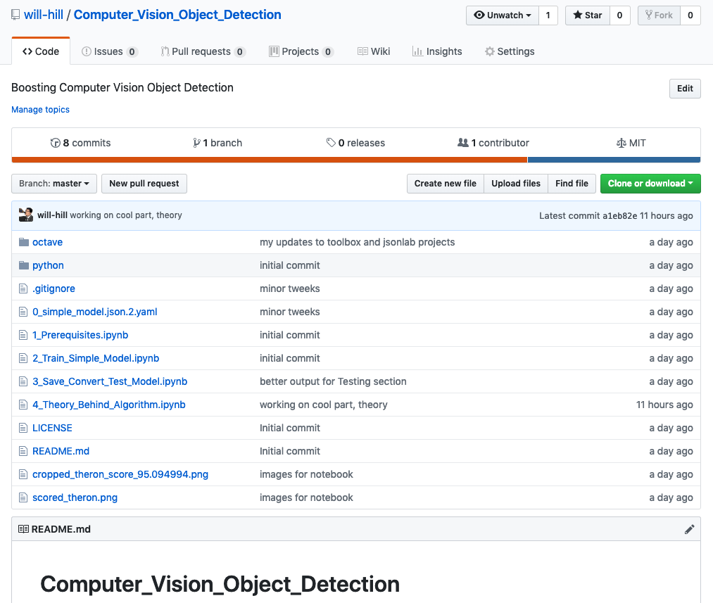
Jupyter Notebook Proof-of-Concept
Notes:
https://www.youtube.com/watch?v=LsK-xG1cLYA

Slide 19
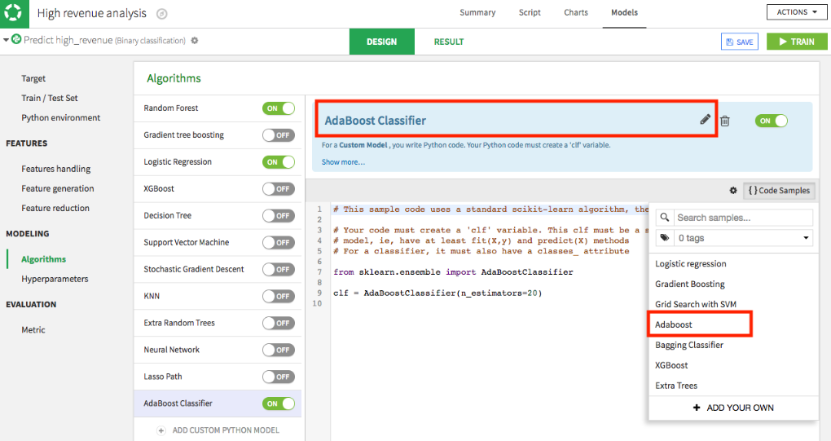
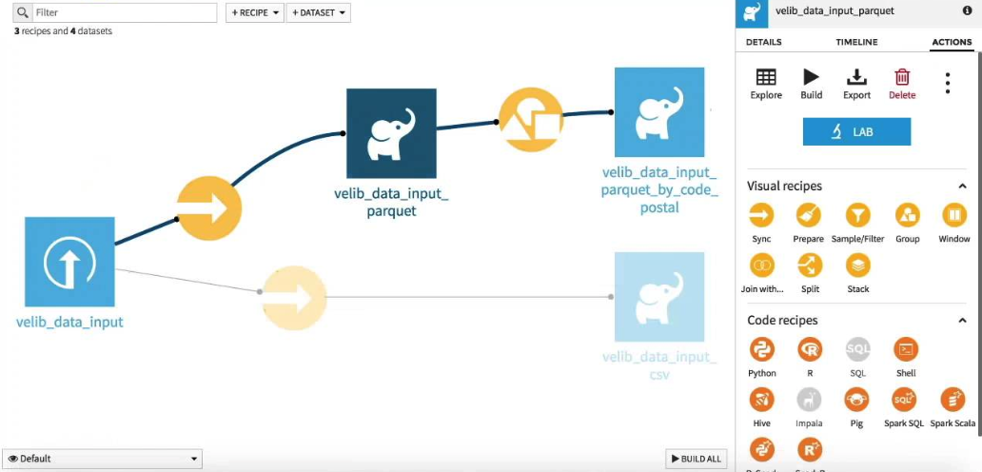
Click & Drag Modeling & Boosting

Slide 20
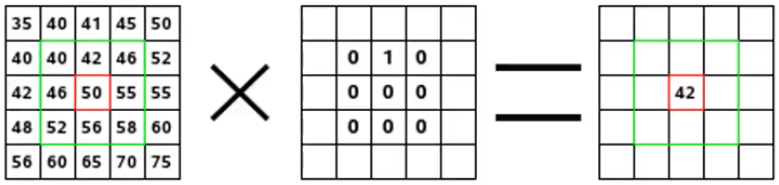
Convolution – kernel applied to pixels
weighted sum of pixels via kernel
images pixels
kernel
convolution

Slide 21
Questions? Me too.
Self-Service AI & Deep Learning

Slide 22
Convolution – kernel applied to pixels
weighted sum of pixels via kernel
images pixels
kernel
convolution

Slide 23

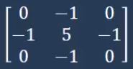
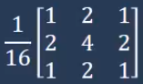
Common Kernels

Slide 24
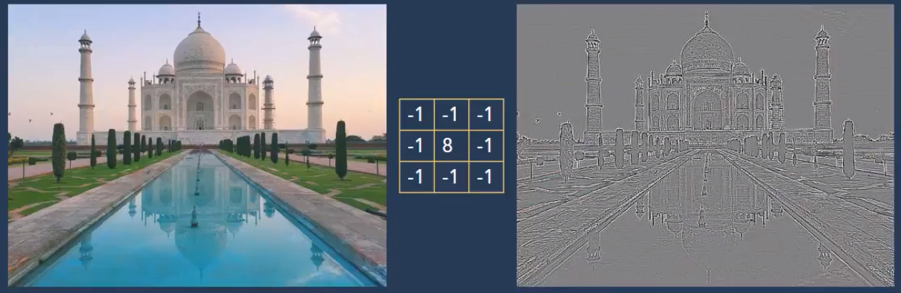
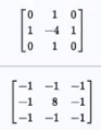
Edge Detection – remove neighbor color
Continuous areas -> grey
Discontinuities -> black & white lines

Slide 25

Color Space
hsv
hue, saturation, value
separates luma, or the image intensity, from chroma or the color information
robustness to lighting changes or removing shadows
hsl – hue, saturation, lightness, similar to hsv
bgr
luv

Slide 26
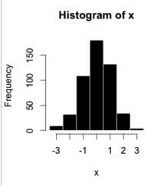
Histogram discretization | binning
bin
bin

Slide 27
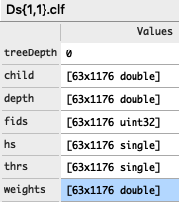
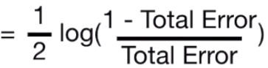
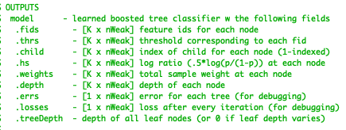
AdaBoost
treeDepth = 0 = variable tree depths
K = number of features
nWeak = number of trees
hs (coefficient)
ie, half log(”odds ratio”)
Classifier =
sum (coefficients[i] * prediction(trees[i], X)

Slide 28
Terms & Abbreviations
Pedestrian datasets: Caltech, INRIA, TUD-Brussels and ETH
PASCAL VOC
Image pyramid
natural image statistics
periodic textures
octave-space, octave and half-octave image pyramids, 42, 43
sparse image pyramids
channel features
aggregate feature channels (afc), 30 fps
integral channel features (icf)
striate cortical cells:wavelet expansion >>>> retinal ganglion cell:pixel
false positives per image (FPPI)
Viola and Jones (VJ), 10+ FFPI, 15 fps
Histogram of Oriented Gradients (HOG), 1 FPPI
more channels, finer scale sampling, enhanced normalization schemes
natural images have fractal statistics, 7, 33, 34
fast feature pyramids (ffp), ffp w/GPU, 100 fps
coarse-to-fine search [51], distance transforms [52]
sliding window paradigm 53, 27
Crosstalk cascades for frame-rate pedestrian detection
cascaded ensembles
image gradients
gradient histograms
gradient angles
Kernel – square matrix of spatial weights for pixels neighborhoods
deformable part models
crosstalk cascades , 35-65 fps, 40
branch and bound search
ROI – region of interest
NMS - Non-Maximal Suppression

